Slide 1
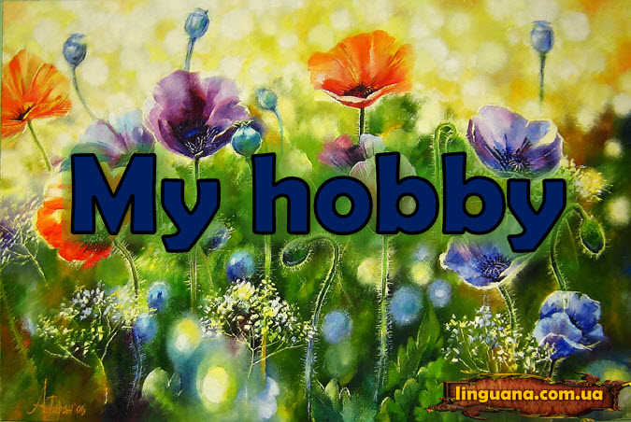
Підготувала вчитель англійської мови Приймак Н.В,
Підготувала вчитель англійської мови Приймак Н.В.

Slide 2
At the lesson
Remember!
You are creative and smart
Be polite
Be attentive
Don’t afraid of making mistakes

Slide 3
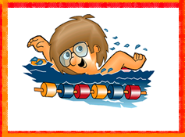





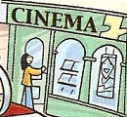
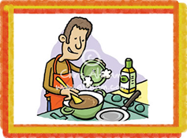
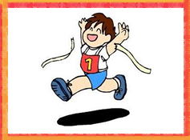
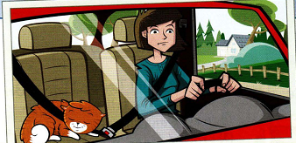
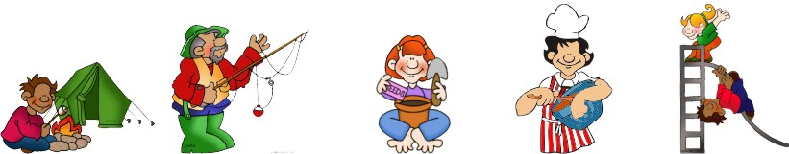


Slide 4
Things people to play
Things people to collect
Hobby
Outdoor activities
Creative hobby

Slide 5
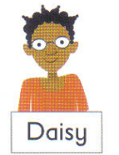
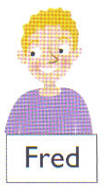
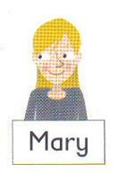
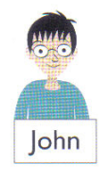
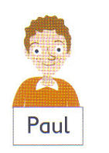
Read and guess
This child with straight black hair and glasses likes being busy with lots of homework. His hobby is reading.
This child loves Art and is fond of painting. He’s got short, brown curly hair.
This child with straight blonde hair thinks Art’s boring. She is interested in watching cartoons.
This child thinks Maths is exciting. She has got curly black hair and glasses.
This child with short curly blonde hair thinks Music’s difficult. His hobby is painting.

Slide 6
Read and guess
This child with straight black hair and glasses likes being busy with lots of homework. His hobby is reading.
This child loves Art and is fond of painting. He’s got short, brown curly hair

Slide 7
Read and guess
This child with straight blonde hair. She thinks Art’s boring. She is interested in watching cartoons.
This child thinks Maths is exciting and has got curly black hair and glasses

Slide 8
This child with short curly blonde hair. He thinks Music’s difficult. His hobby is painting

Slide 9
+
?
Daisy (like) painting.
Fred (play) the piano.
John ( to be) fond of reading.
You (to be) interested in fishing

Slide 10
“TREASURE ISLAND”
 | Collect coins | Play the guitar | Practice yoga | Watch cartoons
I like | 1 | 2 | 3 | 4
I don’t like | 5 | 6 | 7 | 8
I am fond of | 9 | 10 | 11 | 12
Are you interested in ….? | 13 | 14 | 15 | 16
I can | 17 | 18 | 19 | 20

Slide 11
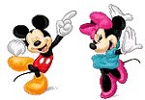
Let’s relax

Slide 12
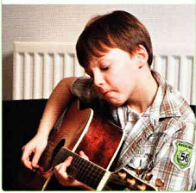
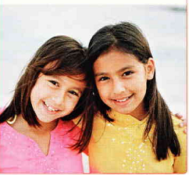
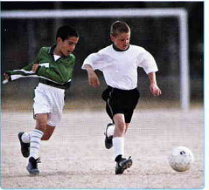
Listen and match
Yusuf
John
Rosa

Slide 13
His name is John. He is 9/11. He is from USA/ UK. He likes playing the guitar/ the piano and painting. He doesn’t like/ like playing chess and he really hates shopping. It’s boring/ interesting
She’s Rosa. She is 7/8. She is from France/ Spain. She likes cooking/ dancing and visiting her family. She loves taking photos/ stamps, too. This is a photo of her and her friend.
His name is Yusuf. He is ten/twelve. He’s Ukrainian/ Egyptian. He likes playing football/ the piano. He doesn’t like/ like playing the volleyball but he likes playing football with his friends.

Slide 14
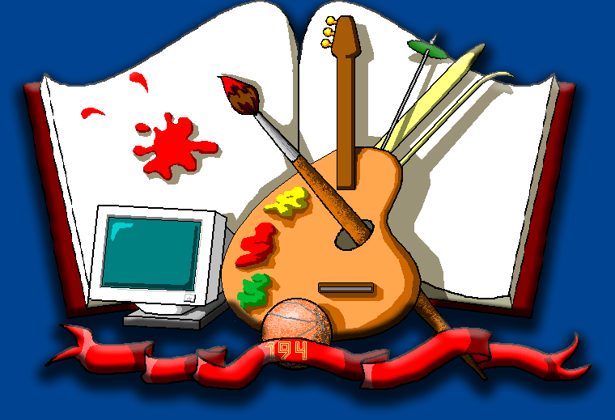
Anton 10 Ukraine

Slide 15

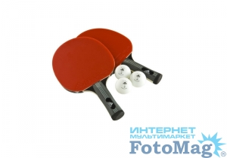

Maria 6 Italy

Slide 16

Homework
Ex. 6. p.65

Slide 17
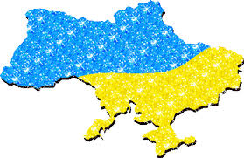
I love my country, because I can… here.

