Slide 1
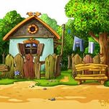
Home, sweet home
Підготувала
вчитель англійської мови Приймак Ніна Василівна

Slide 2
cheese
please
pease
meat
tea
cream
[ i:]

Slide 3
[Λ]
lunch
supper
onion
some
butter

Slide 4
[æ]
carrot
rabbit
apple
jam
fat

Slide 5
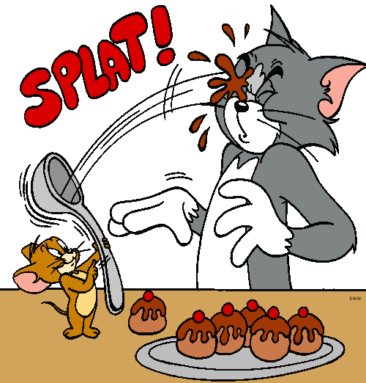
I can’t see anything. What is this?

Slide 6
read and find mistake
has
The girl usually have supper at 7 o’clock.
We always helps mother
My grandmother cook every day.
Father play cricket
The children eats soup
This boy usually watch TV
help
cooks
plays
eat
watches

Slide 7
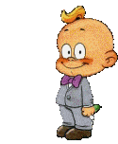






Can you pass me my juice, please?
2
A : Pass me ….. , please.
B : Here you are.
A : Thank you.
3
1
4
6
5

Slide 8
Choose the right column
a | an | some

Slide 9


Let’s Talk a little
What is your favourite cartoon?
My favourite cartoon is…

Slide 10

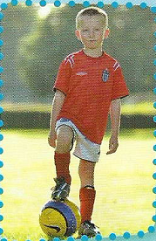
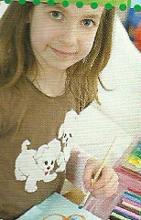
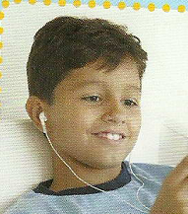
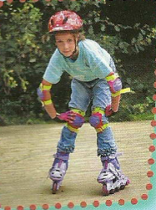
Listen and match
Max
Sara
Julia
Luke

Slide 11

homework
EX.4 p.85

Slide 12
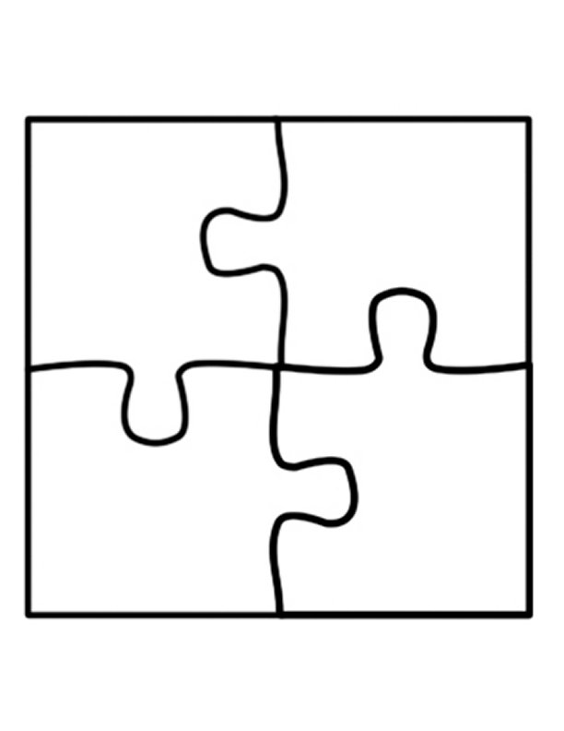
Make some puzzle

Slide 13

Love ukraine

