Slide 1
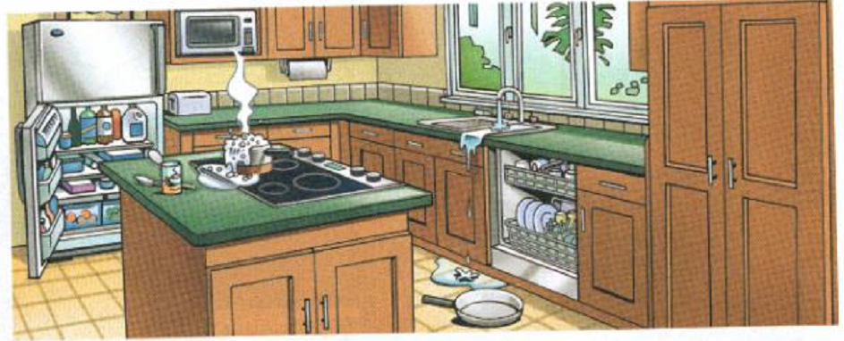
The refrigerator/ freezer door is open
The oven/ dishwasher doesn’t have the door
The stove/ microwave is too hot
There are too much water in the dishwasher/ sink
The pot/ pan is on the floor

Slide 2
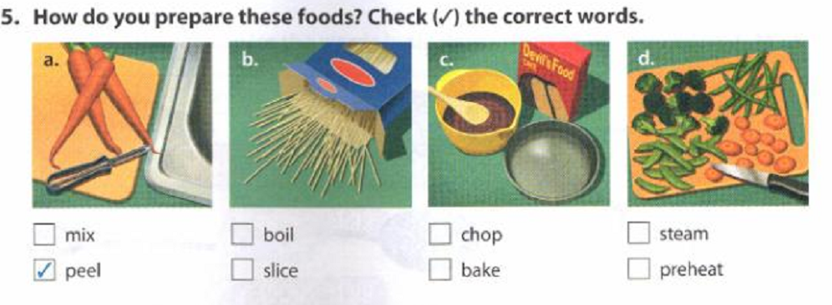

Slide 3
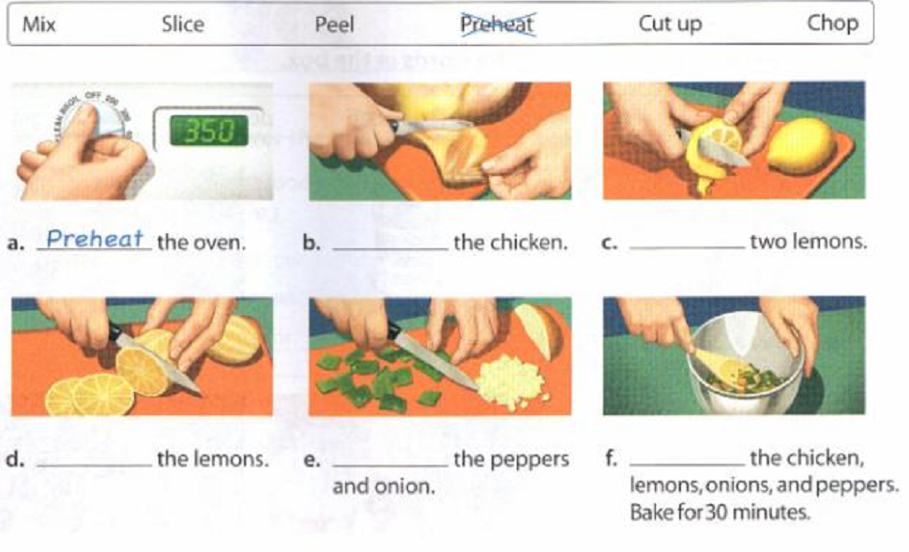
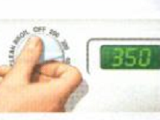
Preheat oven

Slide 4
