Slide 1
Shops and Shopping

Slide 2
Aim:
to recognize new words in the texts, understand their meanings and use them
discussing the topic;
to саrry on a conversation about shops and shopping.

Slide 3
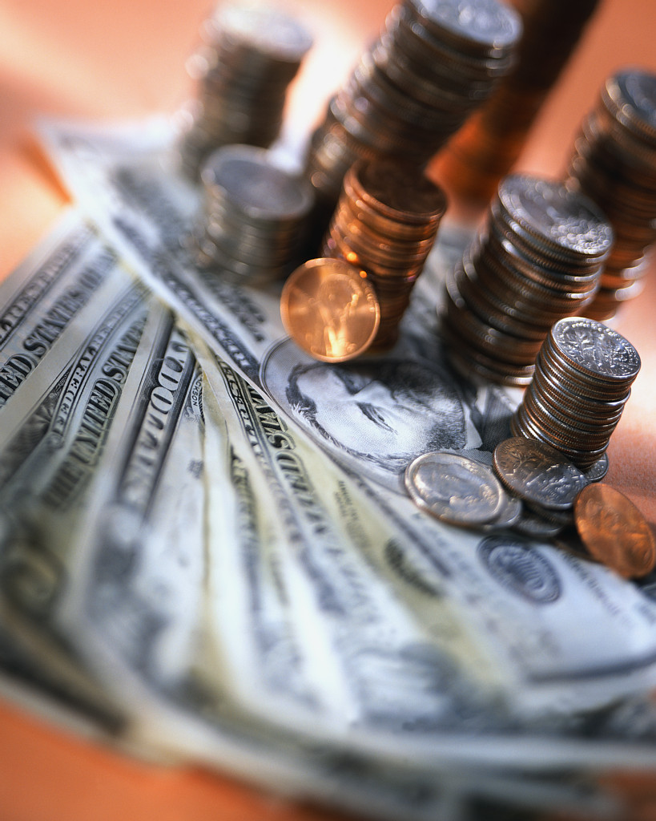

Slide 4
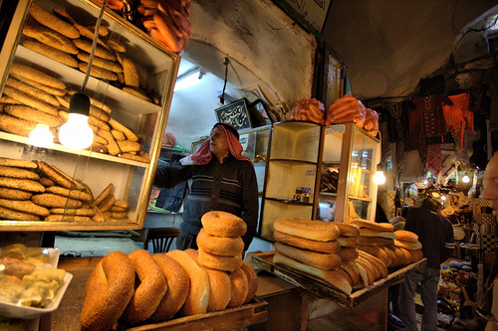
A shop that sells bread and rolls
The baker’s

Slide 5
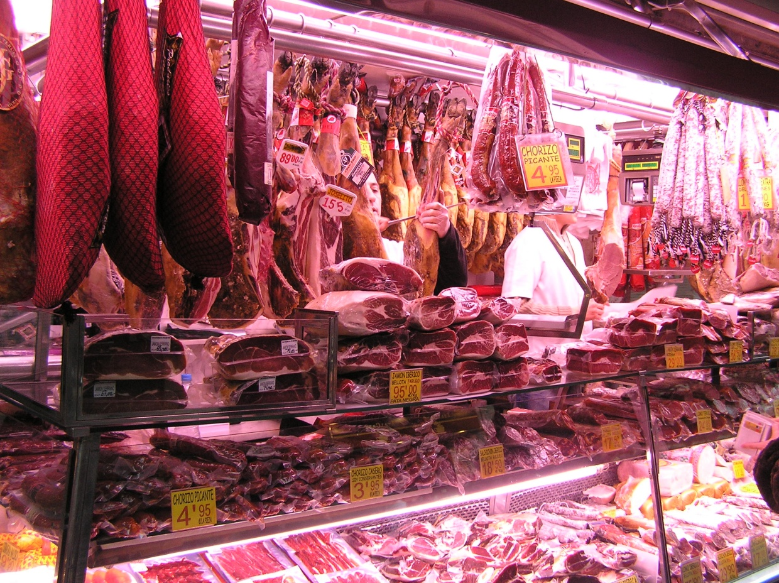
A shop where you can buy meat
The butcher’s

Slide 6
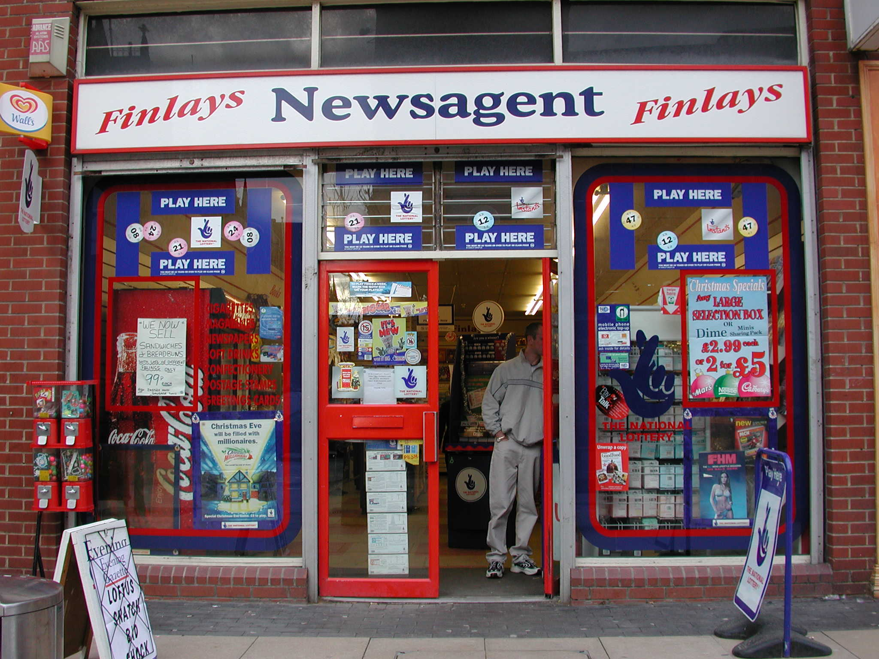
A shop which sells newspapers
The newsagent’s

Slide 7
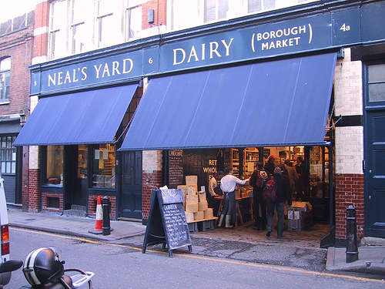
A shop where you can buy milk and cottage cheese
The dairy

Slide 8
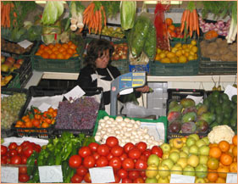
A shop where you can buy vegetables and fruit
The greengrocer’s

Slide 9
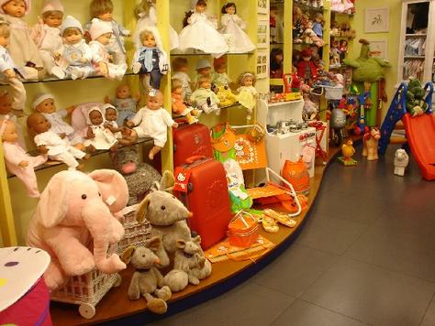
A shop which sells toys
A toy shop

Slide 10
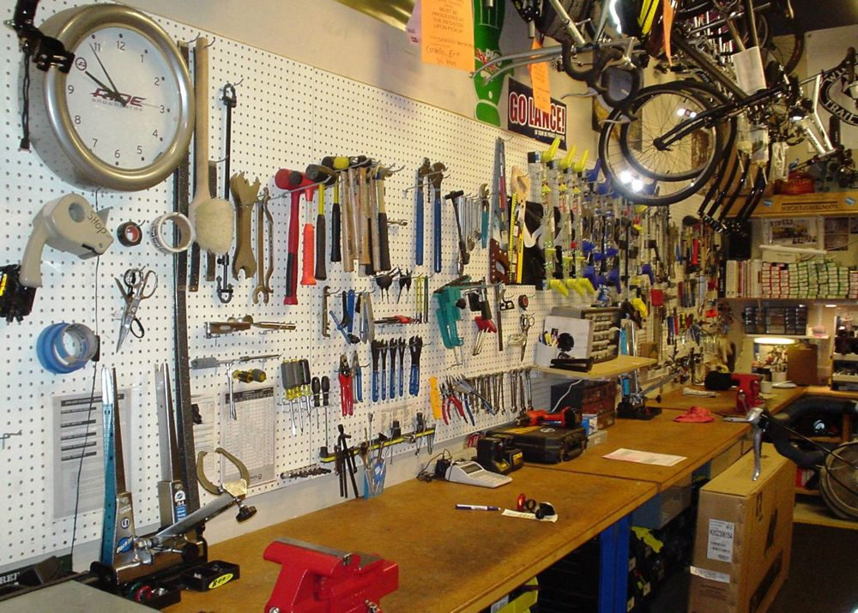
A shop where you can buy things for doing sports
A sports shop

Slide 11
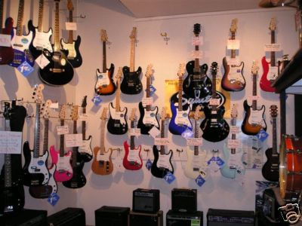
A shop which sells CDs and music instruments
The music shop

Slide 12
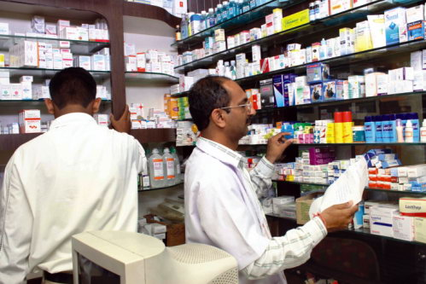
A shop where you can buy medicine
The chemist’s

Slide 13
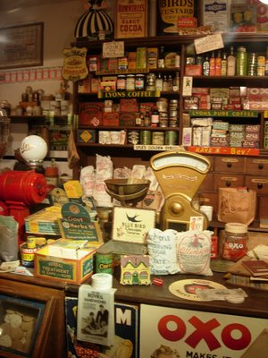
A shop which sells sugar, salt, coffee, tea …
The grocer’s shop

Slide 14
My mother in law bought milk at the bookshop
His wife sold much potatoes
My brother paid many money for this jeans
Her stepmother spent 100 dollar yesterday.

Slide 15
His sister buys bread every day.
Your wife pay 1000 pounds for this coat

